Slide 1

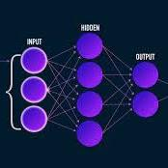

Module 3.5
Neural Networks
Living and Working with Artificial Intelligence
Developed for the AI4GA (Artificial Intelligence for Georgia) project funded by National Science Foundation awards DRL-2049029 and DRL-2048502.
This work is licensed under the Creative Commons. Attribution-NonComercial-ShareAlike 4.0 International License. https://creativecommons.org/licenses/by-nc-sa/4.0/

Slide 2
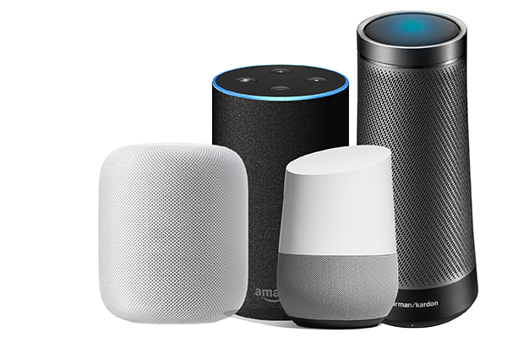
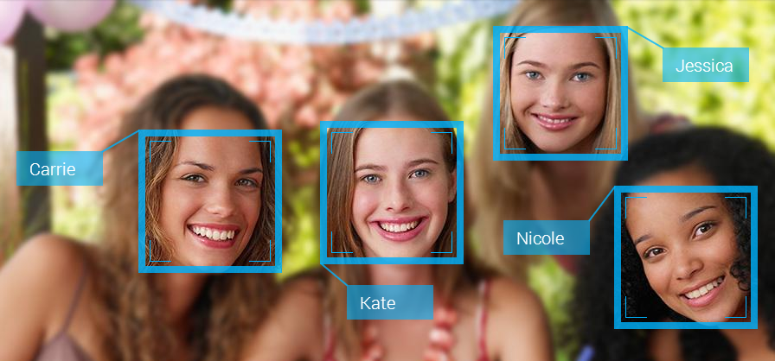
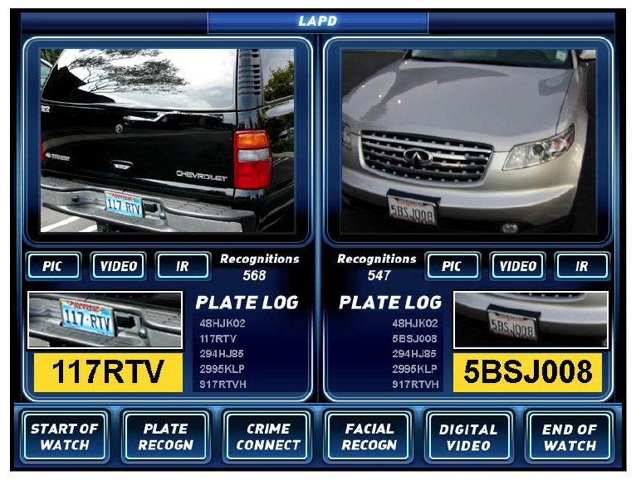
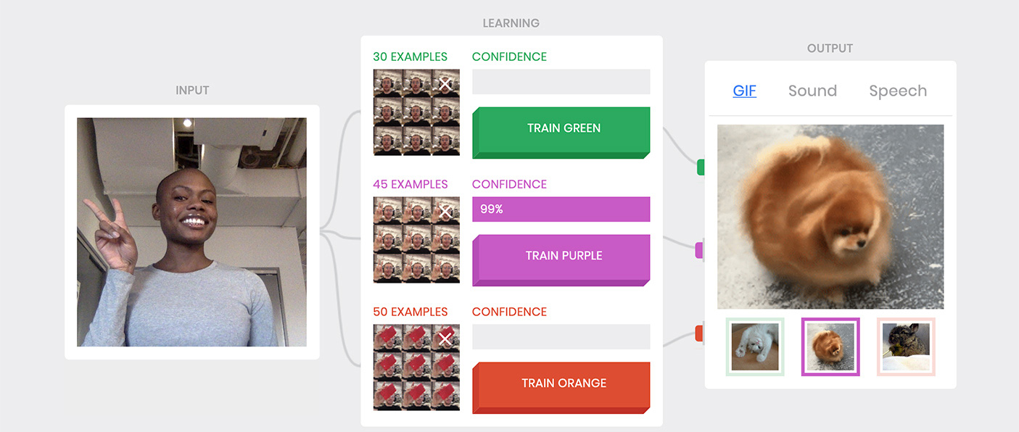
A lot of the AI applications you’ve used have neural networks inside of them.
This is the dominant technology today for many areas of AI.

Slide 3
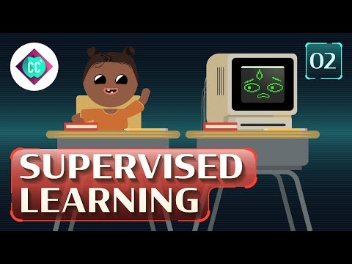
Only in the last 15 years have neural nets become good enough to have practical uses…. Let’s look at where they started
Cue this and add URL

Slide 4
Decision Trees vs. Neural Networks
We learned how to build decision trees. They are useful for some types of problems.
Decision trees require less data to train.
Decision trees can “explain” their conclusions in terms of features we understand.
But for really hard problems, neural networks work better. Why?
Decision trees depend on having a good feature set. What if we don’t?
Neural networks can create their own features. This allows them to come up with sophisticated solutions to hard problems, such as understanding speech or images, that decision trees can’t handle.
Notes:
Make this a visual at some point:
Add picture of at vs dog 100x 100 pixels
10,000 pixels
RGB =
Decision tree would have to look at it one pixel at a time

Slide 5
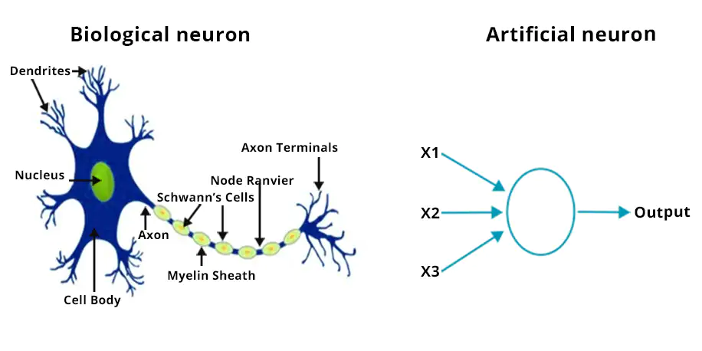
Why are they called “neural” networks?
The human brain contains roughly 86 billion neurons wired together in intricate patterns. This is the inspiration for artificial neural networks.
But biological neurons are more complex than artificial neurons, and real brain wiring is more complex than artificial neural networks.

Slide 6
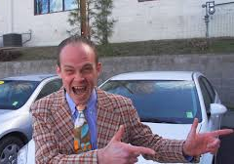
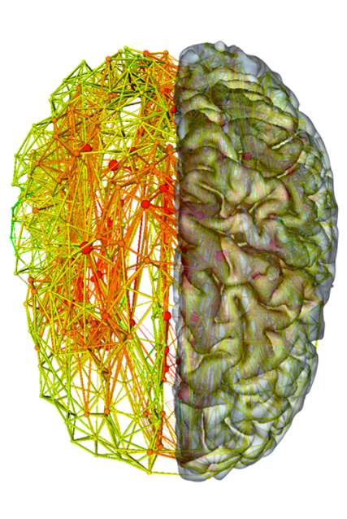
Beware the “hype” around neural networks
Historically, neural networks were inspired by by ideas about how neurons in the brain might work.
But we don’t actually know how our brains reason, learn, imagine, etc. So…
Anyone who tells you that neural nets “work the way the brain does” is wrong. They have bought the hype.
Don’t buy the hype.

Slide 7
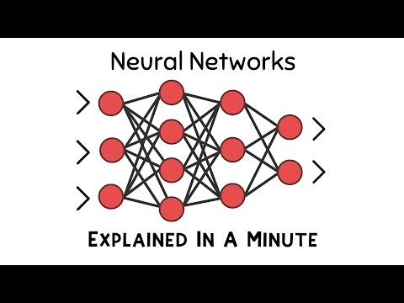
Neural Networks in a Minute
URL (time)

Slide 8
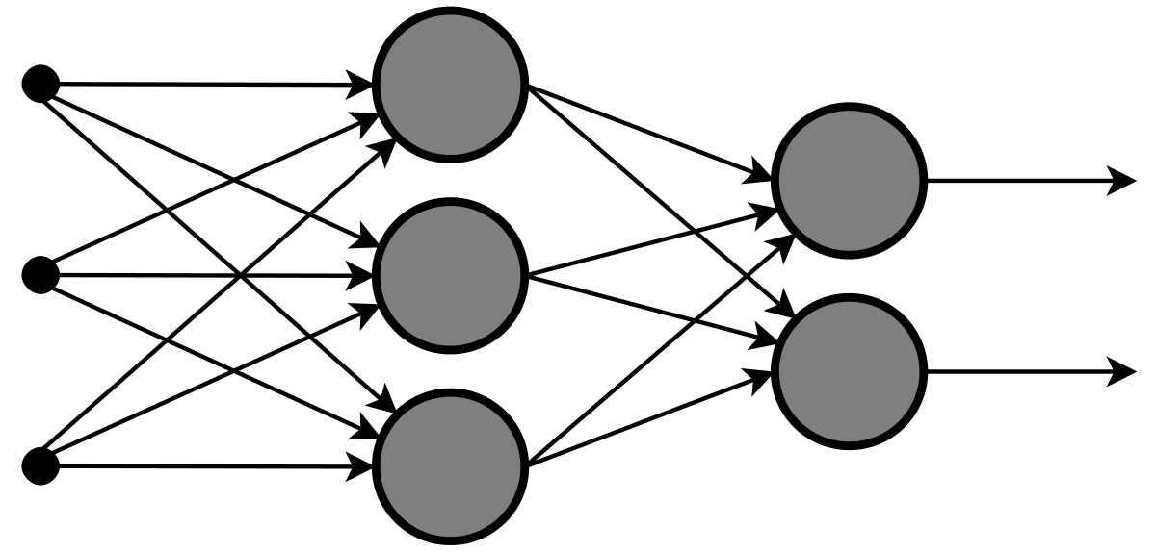
What is a neural network?
A large, complex mathematical function that maps inputs to outputs.
  Because the function is so complex, the network can do sophisticated things.
Each layer is composed of many simple functions, called “units” or “neurons”.
Each unit takes multiple numbers as input and produces a number as output.
units
a number
a number
a number
a number
a number
weighted connections

Slide 9
Neural Networks Are Organized In Layers
Input
Layer
Hidden
Layer
Output
Layer

Slide 10

Deep Neural Networks Have Many Layers
Notes:
Teacher note - this can potentially get really complicated

Slide 11
Let’s focus on how one neuron learns

Slide 12
Learning to predict dog bites
Start with a bunch of “experts”. This is our input layer.
Some experts are good for predicting dog bites.
But which are the good ones?
Every expert starts out with 1 vote.
1 vote
1 vote
1 vote
1 vote
1 vote
1 vote
1 vote

Slide 13

Is this dog going to bite me? (1)
1 vote
NO
Tally
No Yes
4 votes 3 votes
1 vote
NO
1 vote
NO
1 vote
NO
1 vote
YES
1 vote
YES
1 vote
YES
Notes:
Possible Activity for more participatory
Students get a deck of cards with the dog pictures and what the experts will say
Then they get to update their number of votes on their sheet.
Class a a whole completes the tally.
Option1 - Classroom Context: Each person gets to have a card for an expert.
Need Prompting cards
This is what the cards will look like.
Option 2 - Game - Neural Networks invent their own experts..If you have enough experts…you can solve your problem.
Pick a domain where they don’t have personal expertise (intutions) and have to rely on what the experts are saying. But we don’t
Which of these bacteria causes spoiled milk?
Pictures of bacteria
There are some features that cause spoiled milk
You and your friends are building a detector that will do the right things
If your team is successful, you will be able to predict the label successfully …even though you can’t eyeball the input.
At the end we can reveal what the experts are paying attention to.
Level II - no expert that is al
Learning Objective
Using a procedure for

Slide 14


Is this dog going to bite me? (1)
1.1 votes
NO
1.1 votes
NO
Give more votes to the experts who answered correctly. Subtract votes from the ones who got it wrong.
1.1 votes
NO
1.1 votes
NO
Doesn’t bite.
0.9 votes
YES
0.9 votes
YES
0.9 votes
YES

Slide 15

Is this dog going to bite me? (2)
1.1 votes
NO
Tally
No Yes
4.0 votes 3.1 votes
1.1 votes
NO
1.1 votes
YES
1.1 votes
YES
0.9 votes
YES
0.9 votes
NO
0.9 votes
NO

Slide 16
Is this dog going to bite me? (2)
1.0 votes
NO
1.0 votes
NO
Give more votes to the experts who answered correctly. Subtract votes from the ones who got it wrong.
1.2 votes
YES
1.2 votes
YES
Does bite!
1.0 votes
YES
0.8 votes
NO
0.8 votes
NO

Slide 17
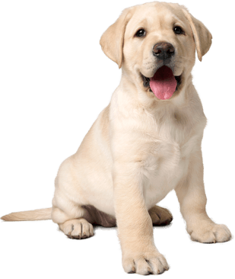
Is this dog going to bite me? (3)
1.0 votes
NO
Tally
No Yes
5.2 votes 1.8 votes
1.0 votes
YES
1.2 votes
NO
1.2 votes
NO
1.0 votes
NO
0.8 votes
YES
0.8 votes
NO

Slide 18
Is this dog going to bite me? (3)
1.1 votes
NO
0.9 votes
YES
Give more votes to the experts who answered correctly. Subtract votes from the ones who got it wrong.
1.3 votes
NO
1.3 votes
NO
Doesn’t bite
1.1 votes
NO
0.7 votes
YES
0.9 votes
NO

Slide 19

Is this dog going to bite me? (4)
1.1 votes
YES
Tally
No Yes
2.5 votes 4.8 votes
0.9 votes
NO
1.3 votes
YES
1.3 votes
YES
1.1 votes
YES
0.7 votes
NO
0.9 votes
NO

Slide 20
Is this dog going to bite me? (4)
1.2 votes
YES
0.8 votes
NO
Give more votes to the experts who answered correctly. Subtract votes from the ones who got it wrong.
1.4 votes
YES
1.4 votes
YES
Does bite!
1.2 votes
YES
0.6 votes
NO
0.8 votes
NO

Slide 21
Turning our dog bite predictor into a neural network
w_{i} are the weights on inputs x_{i} (“weight” = the number of votes that expert gets)
1.2
The experts supply inputs
x_{i} = +1
for “yes” or -1 for “no”
0.8
“neuron”
1.4
Σ^{>0}
1.4
1.2
0.6
0.8
“Activation” a = Σ w_{i}x_{i}
a > 0 means “dog will bite”
Notes:
Neural Nets are like a function
X input -> Y output
Were inputs can map to a number of Y’s

Slide 22
Connections (FIX THIS)
Votes are weights
Experts are
inputs
Features
Also connect back to other examples and bigger pictures

Slide 23
Let’s look at
how the neuron computes its answer
Notes:
Note add a neuron with a magnifying glass

Slide 24
The simplest possible unit: the linear unit
Each input x_{i} is multiplied by the corresponding weight w_{i}. Sum the results.
Inputs
Weights
Summation
Output
x₁
w₁
∑
y
x₂
w₂
x₁ × w₁ + x₂ × w₂ = y
Notes:
Link to Dave’s teaching videos
Teacher note - as a class do slides 30-37
Student activity starts on 38

Slide 25
The simplest possible unit: the linear unit
varying inputs
x₁ | x₂
2 | 3
1 | 4
3 | -2
-2 | -5
fixed weights
x₁
5
∑
4
x₂
-2
x₁ × w₁ + x₂ × w₂ = y
2 × 5 + 3 × -2 = 4
Integer or whole number inputs

Slide 26
The simplest possible unit: the linear unit
x₁ | x₂
2 | 3
1 | 4
3 | -2
-2 | -5
x₁
5
∑
-3
x₂
-2
x₁ × w₁ + x₂ × w₂ = y
1 × __ + 4 × ___ = ___
Enter the missing weights and solve the problem

Slide 27
The simplest possible unit: the linear unit
x₁ | x₂
2 | 3
1 | 4
3 | -2
-2 | -5
x₁
5
∑
19
x₂
-2
x₁ × w₁ + x₂ × w₂ = y
_ × 5 + ___ × -2 = ___
Enter the missing input values highlighted in blue in the table
and solve the problem

Slide 28
The simplest possible unit: the linear unit
x₁ | x₂
2 | 3
1 | 4
3 | -2
-2 | -5
x₁
5
∑
0
x₂
-2
x₁ × w₁ + x₂ × w₂ = y
__ × __ + __ × __ = ___
Enter the missing input values highlighted in blue in the table
Enter the missing weights from the diagram, and
solve the problem

Slide 29
Linear Threshold Unit

Slide 30

The linear threshold unit produces
a binary output
Remember the Perceptron….
x₁
w₁
∑>0
0 for “no” or 1 for “yes”
x₂
w₂
a = x₁ × w₁ + x₂ × w₂ activation - equation or formula
y =
1 if a > 0
Binary outputs - 0 or 1
0 if a ≤ 0

Slide 31
Should I wear boots today?
raining
1
∑>0
wear boots
snowing
1
Use the values in the table to update the sum and output columns.
Note: this unit has a threshold for the sum to be greater than 0 to trigger wear boots
Possible Answers:
1 (Yes) or 0 (No)
Raining? | Snowing? | Sum | Output: Wear Boots
No (0) | No (0) | 0
Yes (1) | No (0) | 1
No (0) | Yes (1) | 1
Yes (1) | Yes (1) | 2
Binary inputs - the input value can only be either yes (1) or no (0).
Notes:
Note - Create student slides /activity sheets for them to work with

Slide 32
Can I make a PBJ sandwich?
Use the values in the table to update the
Sum and output columns.
Note: this unit has a threshold for the sum to be greater than 2 to trigger make a sandwich
Must have peanut butter, jelly, and bread.
Peanut butter | Jelly | Bread | Sum | Output: Sandwich
No (0) | No (0) | No (0) | 0 | 0 (No)
Yes (1) | No (0) | No (0) | 1
No (0) | Yes (1) | No (0)
Yes (1) | Yes (1) | No (0)
No (0) | No (0) | Yes (1)
Yes (1) | No (0) | Yes (1)
No (0) | Yes (1) | Yes (1) | 2
Yes (1) | Yes (1) | Yes (1)
peanut butter
1
∑>2
1
can make sandwich
jelly
1
bread

Slide 33
Unequal Weights

Slide 34
Does John get to eat dessert tonight?
If he ate his vegetables, finished his milk, and cleared the table, then yes.
But if the dessert is healthy (fruit, not cake or ice cream), he can always have it.
Healthy Dessert | Ate Vegetables | Finished Milk | Cleared Table | Sum | Output
No (0) | No (0) | No (0) | No (0) | 0 | 0
Yes (1) | No (0) | No (0) | No (0)
No (0) | No (0) | Yes (1) | No (0)
No (0) | Yes (1) | No (0) | Yes (1)
No (0) | Yes (1) | Yes (1) | Yes (1)
Yes (1) | Yes (1) | Yes (1) | Yes (1)
healthy dessert
5
ate veggies
1
∑>2
gets
dessert
1
finished milk
1
cleared table
Use the values in the table to update the sum and output columns.
Note: this unit has a threshold for the sum to be greater than 2 to trigger gets dessert.

Slide 35
Negative weights

Slide 36
Negative weights: can Lucy buy garden supplies?
She can buy supplies if the store is open and she has money, unless her car is out of gas or has a flat tire.
Store open | Have money | Out of gas | Flat tire | Sum | Output
No (0) | No (0) | No (0) | No (0)
Yes (1) | No (0) | No (0) | No (0)
No (0) | Yes (1) | No (0) | Yes (1)
Yes (1) | Yes (1) | No (0) | No (0)
Yes (1) | Yes (1) | Yes (1) | No (0)
store is open
1
has money
1
∑>1
can buy supplies
-5
out of gas
-5
flat tire
Use the values in the table to update the sum and output columns.
Note: this unit has a threshold for the sum to be greater than 1 to trigger can buy supplies

Slide 37
Numbers as inputs

Slide 38
Integer instead of binary inputs: Can we go on a class trip?
The number of adults must exceed the number of children.
Inputs to the network are integers.
# adults
1
# of Adults | # of Children | Sum | Output
1 | 1
2 | 3
3 | 2
5 | 5
7 | 3
∑>0
can go
# children
-1
Use the values in the table and weights in the diagram to update the sum and output columns.
Note: this unit has a threshold for the sum to be greater than 0 to trigger can go

Slide 39
Exercise: Can I go on this roller coaster?
You can go on the roller coaster if you have a ticket, are tall enough, and are not carrying any drink with you.
have ticket
w₁
∑>?
w₂
can go
on ride
carrying drink
w₃
tall enough
What should the values of w₁, w₂, w₃, and the threshold be?
Hint: Choose numbers positive or negative for the weights and threshold values
Notes:
TO DO: Revision - Add graphics to make this visual … also revise with strategiies
Strategy - start with 1 for all weights
Strategy - Veto - instant negative weights
Strategy - What is the case where I can go - Input: 101 needs to be above threshold. Otherwise, not threshold
Artist - some of them are tall and some of the are short, some with drinks, and some with tickets.

Slide 40
Draw a neural network to answer this question:
Exercise: Should we break for lunch?
There are 5 team members (x₁ x₂, x₃, x₄, x₅)
An Input x_{i} is 1 when team member i is hungry; otherwise it’s 0.
Break when more than half of the team is hungry.
What should the neural network look like?

Slide 41
Negative threshold: can I buy milk?
If the supermarket is closed, buy at the bodega.
If the bodega is closed, buy at the supermarket.
If both are closed, cannot buy milk.
supermarket
closed
-1
∑>?
super closed | bodega closed | Sum | Output
0 | 0 | 0 | 1
1 | 0 | -1 | 1
0 | 1 | -1 | 1
1 | 1 | -2 | 0
can buy milk
bodega
closed
-1
What should the threshold be?

Slide 42
Challenge Questions

Slide 43
“Mismatch” Function (Exclusive OR)
“Mismatch” outputs a 1 when its two inputs disagree: exactly one of them is a 1.
The technical name is “exclusive OR”, or “XOR”.
Can we compute XOR using a single linear threshold unit?
x₁ | x₂ | x₁ XOR x₂
0 | 0 | 0
1 | 0 | 1
0 | 1 | 1
1 | 1 | 0
x₁
w₁
∑>?
x₁ XOR x₂
x₂
w₂

Slide 44
“Mismatch” Function (Exclusive OR)
“Mismatch” outputs a 1 when its two inputs disagree: exactly one of them is a 1.
The technical name is “exclusive OR”, or “XOR”.
Can we compute XOR using a single linear threshold unit?
No!
We can prove mathematically that XOR cannot be computed by a single linear threshold unit.
… But we can compute XOR using hidden units.
x₁ | x₂ | x₁ XOR x₂
0 | 0 | 0
1 | 0 | 1
0 | 1 | 1
1 | 1 | 0

Slide 45
Mismatch Solution 1
“x₁ and not x₂”
x₁ | x₂ | x₁ XOR x₂
0 | 0 | 0
1 | 0 | 1
0 | 1 | 1
1 | 1 | 0
∑>0
1
1
x₁
-1
∑>0
-1
x₂
1
∑>0
1
“(x₁ and not x₂) or
(x₂ and not x₁)”
“x₂ and not x₁”
Hidden Units Output Unit

Slide 46
Mismatch Solution 2
“x₁ or x₂”
x₁ | x₂ | x₁ XOR x₂
0 | 0 | 0
1 | 0 | 1
0 | 1 | 1
1 | 1 | 0
∑>0
1
1
x₁
1
∑>0
1
x₂
1
∑>1
-1
“(x₁ or x₂) and not
(x₁ and x₂)”
“x₁ and x₂”
Hidden Units Output Unit

Slide 47
Pro tip: replace thresholds with bias connections
We can replace the threshold t with a bias connection with weight w₀ = -t. This lets us fix the threshold at 0 for all units. Now our units only have one type of parameter (the weight vector) instead of two types, which simplifies things.
x₁
w₁
x₁
w₁
∑>t
∑>0
w₂
w₂
x₂
y
x₂
y
w₃
w₃
x₃
x₃
w₀ = -t
1
bias connection

Slide 48
Module 3.5 Takeaways

Slide 49
Learning Algorithms
Building neural nets by hand requires careful attention to the weights.
  Only feasible for small networks.
What we need is a learning algorithm that can set the weights for us.
All we have to do is show it some training data so it knows what output we want to produce for each input.
The “will this dog bite me” network was trained using a very simple learning algorithm...

Slide 50
Relationship between Big Ideas 2 and 3
The dog bite predicting neural network is doing reasoning.
  It’s solving a classification problem.
The input representation used by the network is a feature vector.
  Each expert contributes one feature.
  The features could be binary (-1/+1) or real values from -1 to +1.
Another important representation is the weight vector.
The learning algorithm adjusts the weight vector so as to improve the performance of the reasoner. Once learning is complete, using the network to classify new dog images is reasoning (Module 3.1).

Slide 51
The neural net learning rule
Neural net learning rules describe how weights change with experience.
We can write the learning rule for our dog bite network as an equation that explains how the weight w_{i} of the ith expert changes based on the output x_{i} and the desired output d (from the teacher) for the current training example.
Δw_{i} = 0.1 · x_{i} · d Notation: Δw_{i} (delta w_{i}) means “change in w_{i}”
Notice that if x_{i} and d are either both +1 or both -1, the weight w_{i} will increase. If they have opposite signs, the weight will decrease. If x_{i} is zero, w_{i} will not change.
This is a very simple learning rule that doesn’t work for networks with hidden layers. Most neural nets use something more complex, but the form is similar.

Slide 52
Backpropagation learning rule: allows for hidden layers
Error signal
Mean Square Error (d-y)²
y = actual output
d = desired output

